Slide 1
Hot Standby Router Protocol

Slide 2
FHRP » First Hop Redundancy Protocol » Default-Gateway Redundancy • HSRP • VRRP • GLBP

Slide 3
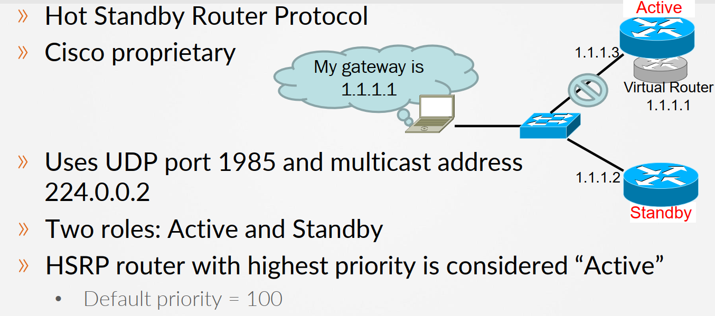
HSRP
HSRP

Slide 4
HSRP
» MAC address: 0000.0c07.acxx • xx refers to the group number in hexadecimal » Preemption disabled by default » HSRP/VRRP = No load-sharing feature » MHSRP can be used for load sharing

Slide 5
Implementing Basic HSRP
» Enabling HSRP in the interface • Switch(config-if)# standby <group-id> ip <virtual-ip> » Configuring priority • Switch(config-if)# standby <group-id> priority <priority> » Enabling preemption • Switch(config-if)# standby <group-id> preempt

Slide 6
Verifying HSRP
» Verification commands • Switch# show standby • Switch# show standby brief

